Slide 1

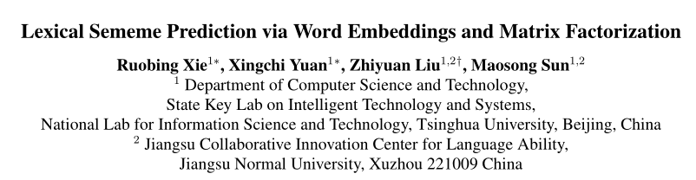

Slide 2
Abstract
Sememes (义原) are minimum semantic units of word meanings, and the meaning of each word sense is typically composed by several sememes. Since sememes are not explicit for each word, people manually annotate word sememes and form linguistic common-sense knowledge bases.
In this paper, we for the first time explore to automatically predict lexical sememes based on semantic meanings of words encoded by word embeddings.

Slide 3
Contribution
This work is the first attempt to automatically predict sememes for words, and we propose two methods for solving sememe prediction.
We evaluate our models on a real-world dataset HowNet and achieve promising results.
We also conduct detailed exploration for deep understanding of the relationships between words and sememes.

Slide 4

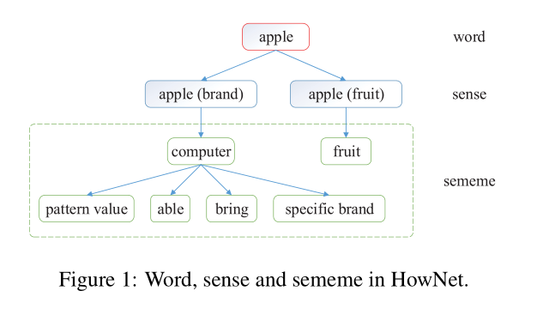
HowNet

Slide 5
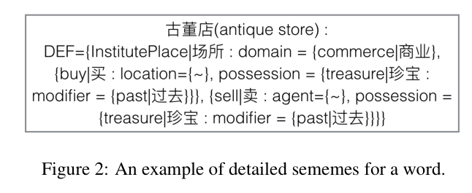
HowNet
1

Slide 6
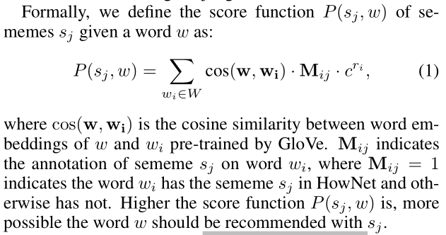
Sememe Prediction with Word Embedding
相似的词具有相似的义原

Slide 7
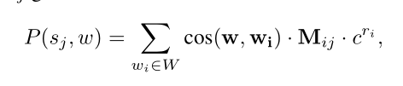
Sememe Prediction with Word Embedding
不相关的词具有完全不同的义原，会对义原的预测带来噪音
提出衰减因子 r_{i ，}相似度的排序
c是超参数

Slide 8
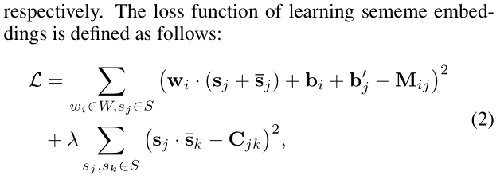
Sememe Prediction with Sememe Embedding

Slide 9
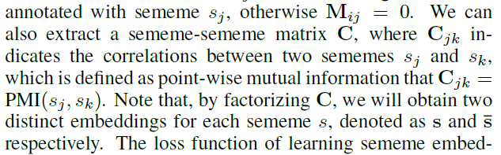
Sememe Prediction with Sememe Embedding
义原-义原矩阵C，进行义原分解
词-义原矩阵M

Slide 10
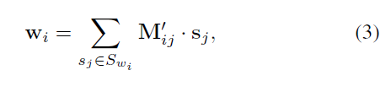
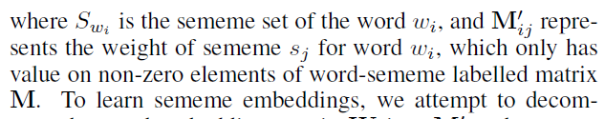
Aggregated Sememe Embeddings
在词-义原空间中，词向量由构成它的义原向量相加而成
1

Slide 11
Dataset
HowNet :212,539 senses belonging to 103,843 words.
Sememes about 2000 (1400 used)
Sogou-T corpus about 2.7billion words to train word embeddings

Slide 12
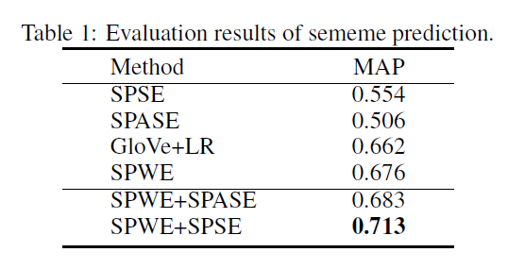

Slide 13
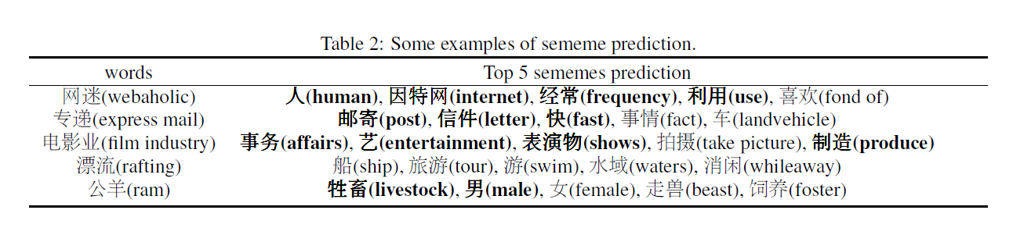

Slide 14
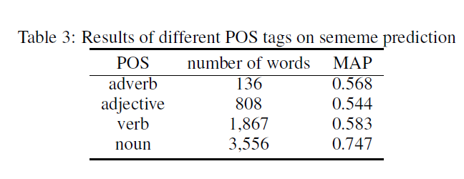

Slide 15
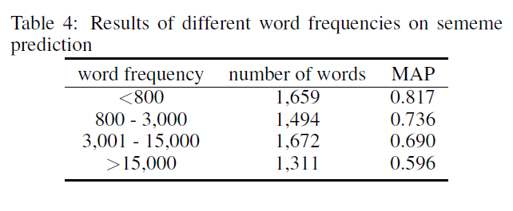
1

